Slide 1


OPTIMAL EV
ROUTING
BY VANSH SINGH 2101CS79

Slide 2

CONTENT
01
PROBLEM STATEMENT
02
GOALS AND OBJECTIVES
03
APP VERSIONING AND REVISIONS
04
FUTURE PROSPECTS
05
CONCLUSION

Slide 3

PROBLEM STATEMENT
School Bus Routing Problem (SBRP) is a challenging NP-hard problem in the field of transportation that involves creating effective routes for school buses to pick up and drop off students. It involves:
Capacity constraints: Number of students that can be accommodated in the Bus etc.
Time constraints: The maximum drop off time for each student is minimised.
Cost optimization: Minimum cost to be spent for transportation.

Slide 4





GOALS AND OBJECTIVES
Objective n° 1
Objective n° 2
Objective n° 3
To provide GUI (Graphical User Interface) with Google Maps! to display routes and solve the School Bus Routing Problem in real time dynamically
To provide innovative solutions specifically for EV vehicles by including their battery percentage, battery charging stations, cargo weight, speed etc.
Apply it to real life situations like Garbage Collection, Depot Cargo Delivery for better and efficient transportation and savings by reducing latency with parallel API calls and refactoring

Slide 5
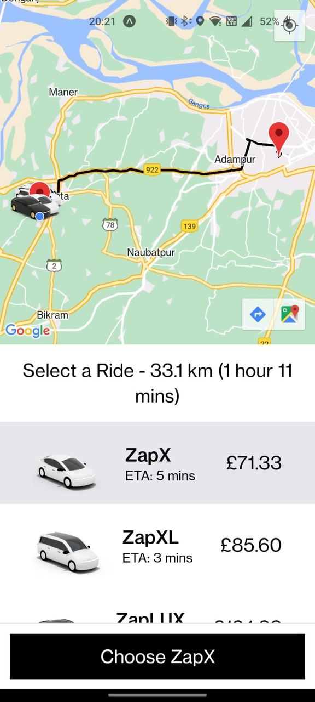



FIRST BUILD v1.0
Platform independent React Native application for mobile systems with ability to select single source - single destination. Built keeping in mind about ZapCab - Cab Sharing App built earlier.
Reports the estimated cab arrival time, source to destination distance, source to destination time based on real time traffic data and the approximate cost based on actual estimated fuel consumption values (doesn’t include option for EVs).

Slide 6

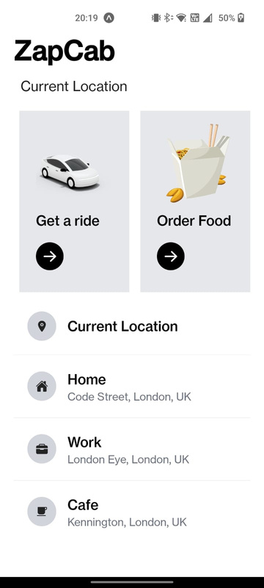
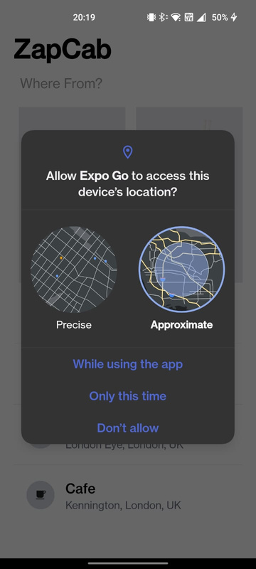
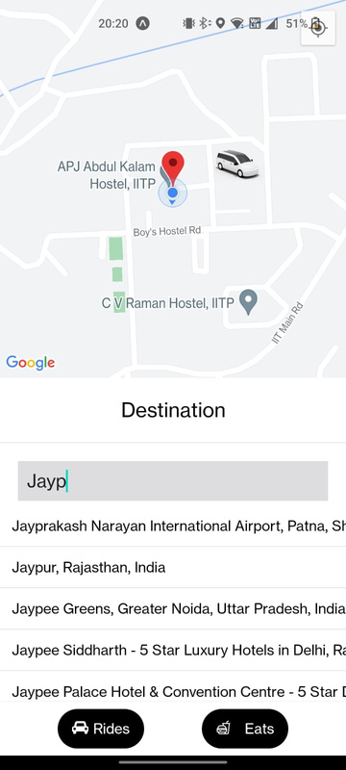
01
HOME PAGE
LOCATION ACCESS
DESTINATION
TRIP
Landing home page. Select Source using 3 methods - Google Autocomplete Search, Current Location using GPS Access or Most-frequently travelled tab
Ability to get Current Location requires Permission. Separate platform independent permissions supported for both iOS and Android
Similar selection options as Source. Points a marker at the Source with Cabs shown nearby the Source with a car marker..
Plots fastest Source to Destination Route with Time, Distance and Cost Matrix APIs of Google Cloud

Slide 7
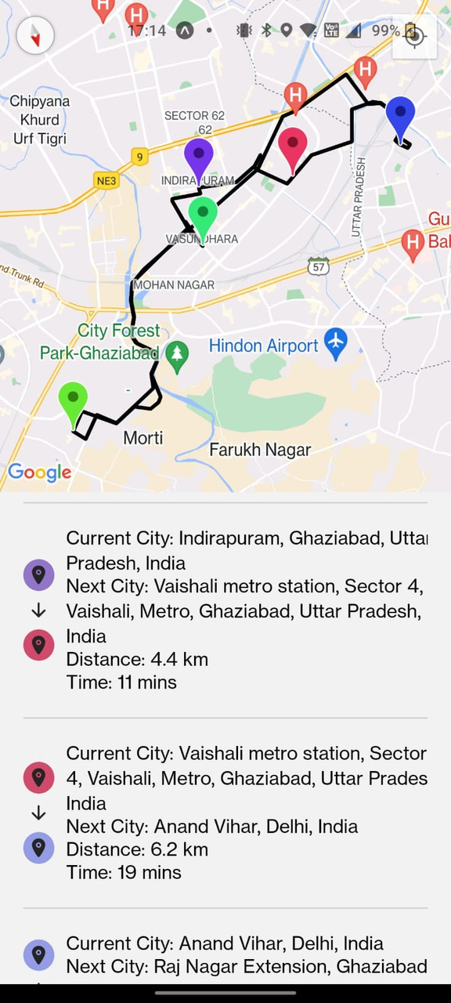
SECOND BUILD v2.0
Using Node.js and Express.js in the backend, we are now able to process single source-multiple destination queries from the frontend more effectively using Travelling Salesman Problem solution based on heuristics like Nearest Neighbours.
Reports the current city, the next city, the distance and the time based on real time traffic data and the approximate cost based on actual estimated fuel consumption values (still doesn’t include option for EVs).

Slide 8
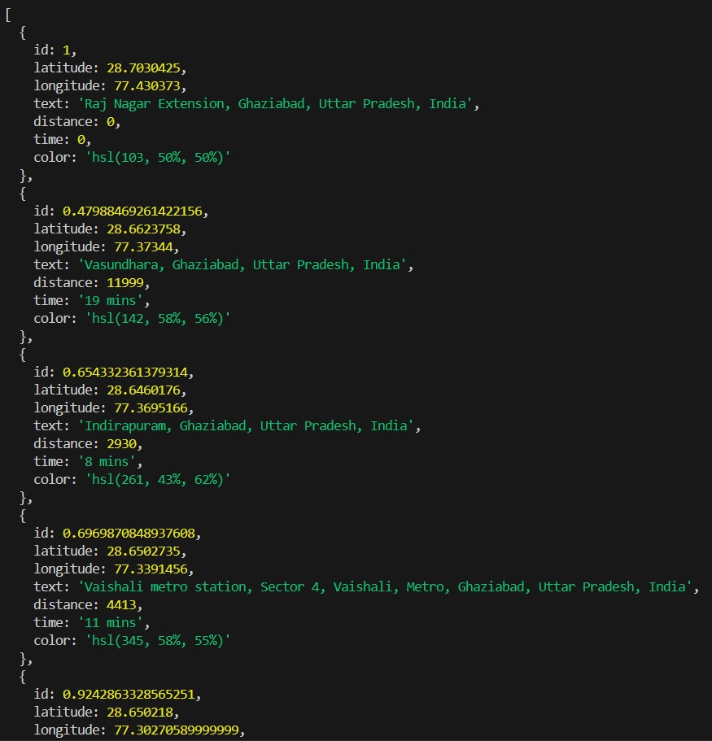
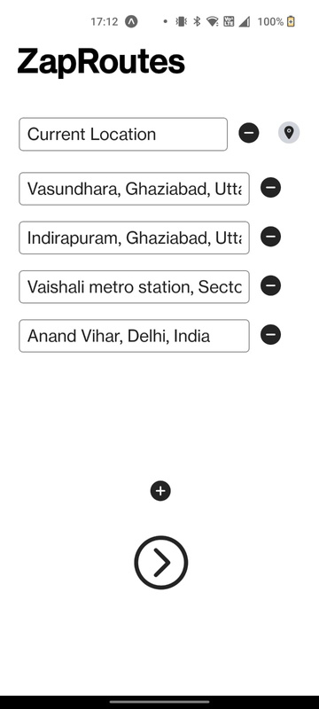
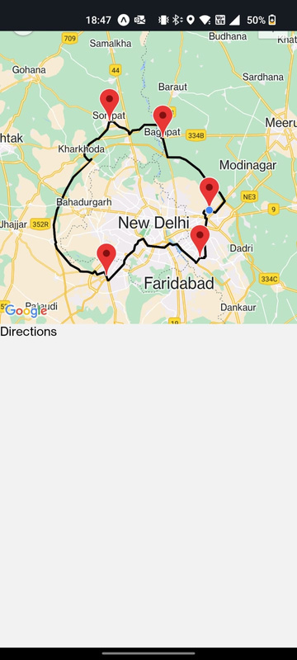
01
HOME PAGE
EARLY DEVELOPMENT
FINAL BUILD UI
BACKEND
Select Source using 2 methods - Google Autocomplete Search, Current Location using GPS. Select Multiple Destination with Google Autocomplete
Ability to plot TSP Route for single source - multiple destination. However, no helpful GUI for users was provided
Final build released with coloured pins for user-friendly UI/UX. Similarly, Current, Next, Time and Distance was added
Built on Node.js and Express, it solves the TSP using Heuristics and calls Google Cloud APIs parallelly for average response time of 80ms

Slide 9
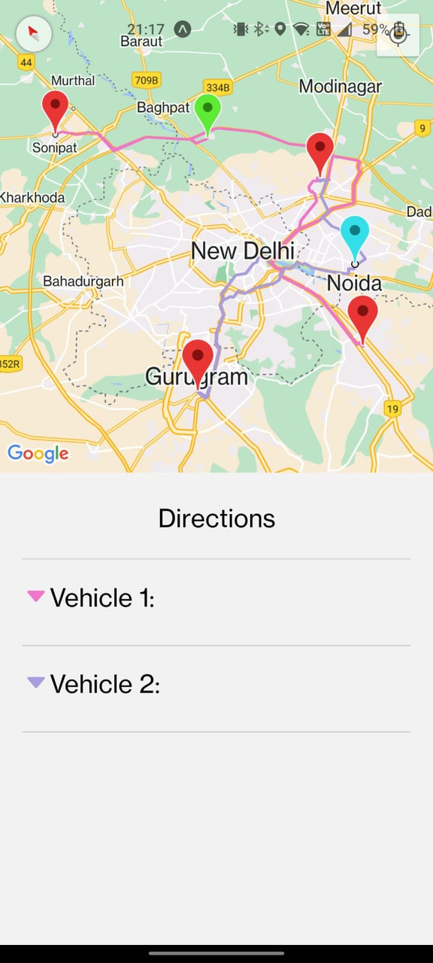
FINAL BUILD v3.0
The latest version now integrates support for Electric Vehicles, enabling users to incorporate Battery Charging and Swapping Stations along the routes. Additionally, routes are optimized considering factors such as weight capacity, vehicle speed etc.
Reports the current city, the next city, the time and the approximate cost incurred based on actual battery consumption/swapping values. C++ backend supports minimum latency with average response time of 80ms.

Slide 10
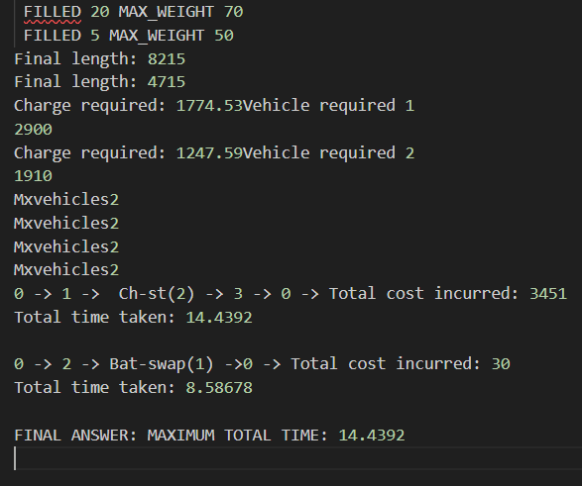
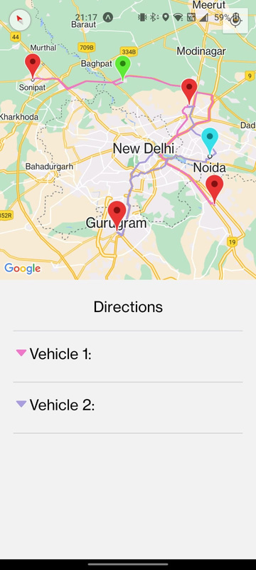
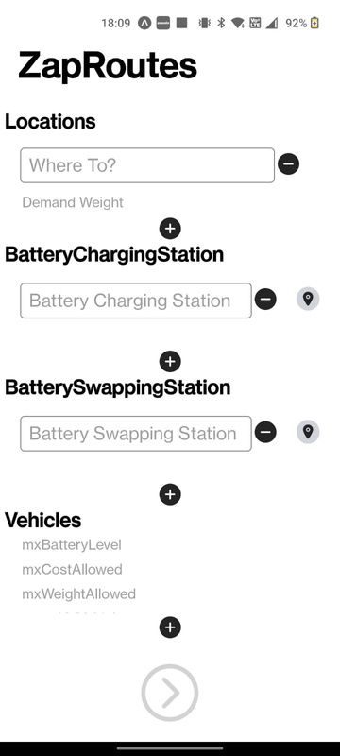
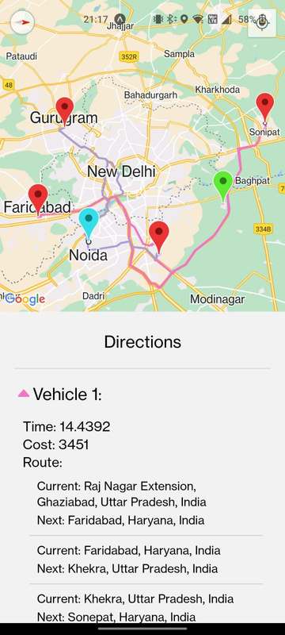
01
HOME PAGE
USING STATIONS
MULTIPLE VEHICLES
BACKEND
Select Locations, Battery Charging Stations and Battery Swapping Stations using Google Autocomplete. Also set each vehicle’s parameters for accurate routing.
The EV Vehicles can now utilise the Battery Charging and Swapping Stations to complete their route. Blue Marker - Battery Swap Station. Green Marker - Battery Charge Station
Whether a vehicle is big or small, we now have the ability to plan routes based on Battery Percentage, Capacity, Speed, Cargo Weight etc.
Built on C++ and Node.js, it solves the TSP using Heuristics and calls Google Cloud APIs parallelly for decrease in latency time of 100ms.

Slide 11

FUTURE PROSPECTS
Improve UI and implement Animations in later stages. Seperate application for Drivers and option for real-time tracking
Deal with multiple sources and then implement the same algorithm using Heuristics
Implement better heuristics which take much lesser time for Optimal Route calculation for faster serve times and user retention
UI CHANGES
MULTIPLE SOURCES
BETTER HEURISTICS

Slide 12

THANK YOU

